Slide 1
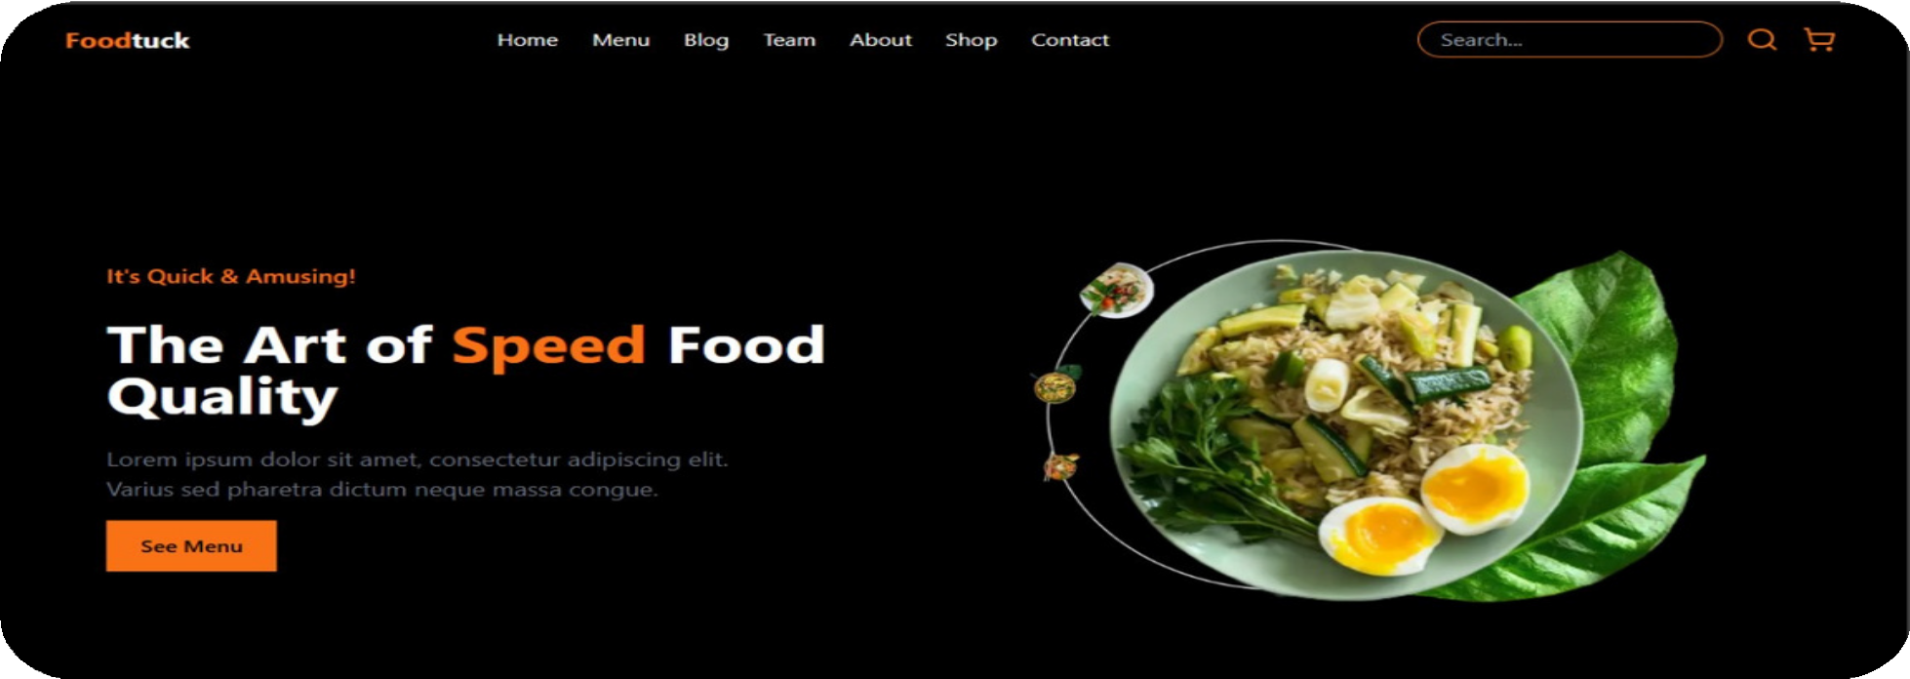
Foodtuck
J U S T A C L I C K A W A Y
MARIUM SHAHZAD

Slide 2

Foodtuck – Instant Online Q- Commerce for Food Businesses
MARIUM SHAHZAD

Slide 3
M I S S I O N
Problem and opportunity Why this works
Solution
Person behind this Features and experience
How will we reach costumers Path to integration Transforming food industry

Slide 4
P R O B L E M & O P P O R T U N I T Y
Luxury Food Experiences – Now Affordable, Accessible, and Instant.
Conflict:
Customers crave premium food but face high prices at restaurants or limited access to specialty items.
Small gourmet businesses struggle to reach audiences beyond their locality, despite offering unique, high-quality products.

Slide 5
W H Y T H I S W O R K S
Emotional Hook: Appeals to customers’ desire for indulgence without guilt.
Data-Driven: Uses stats to validate demand for affordable premium food.
Clarity: Positions Foodtuck as the bridge between luxury and affordability.

Slide 6
P R O B L E M & O P P O R T U N I T Y
Foodtuck’s Opportunity:
Democratize luxury:
Partner with premium vendors to offer discounted, high-quality food delivered instantly.
Win-Win situation for both:
Business gain volume sales; customers enjoy gourmet meals at 30% lower prices.

Slide 7
Foodtuck: Your One-Stop Q-commerce Platform.
S O L U T I O N
Features:
Instant Online Store: A website with food-specific templates.
Smart Order Management: Real-time tracking for vendors and customers.
Built-in Payments: Secure, one-click checkout via Stripe/Razorpay.
Delivery Coordination: Auto-assign drivers or enable pickup.

Slide 8
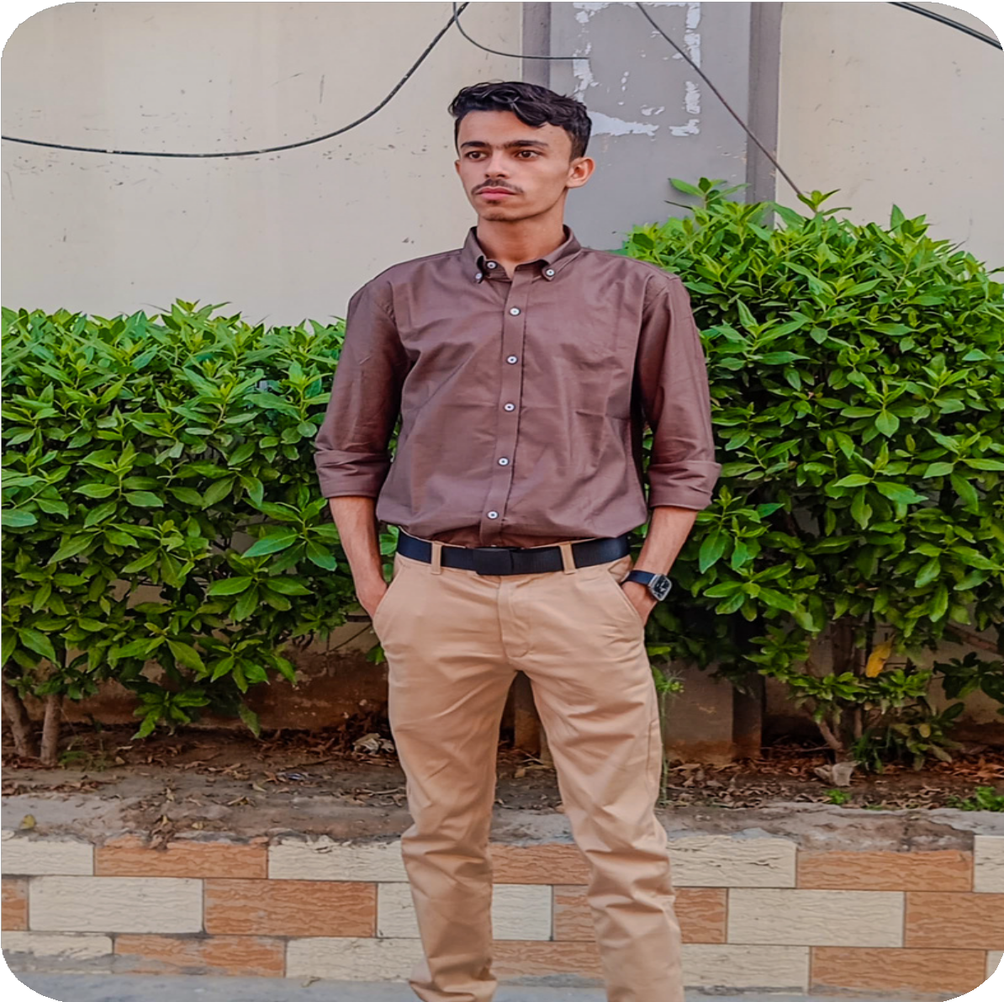
Muhammad Shezan NextJs developer
T H E P E R S O N B E H I N D T H I S
You can ask me for making a fully functional dynamic website while using latest technologies, according to your design.
Currently studying Agentic AI.

Slide 9
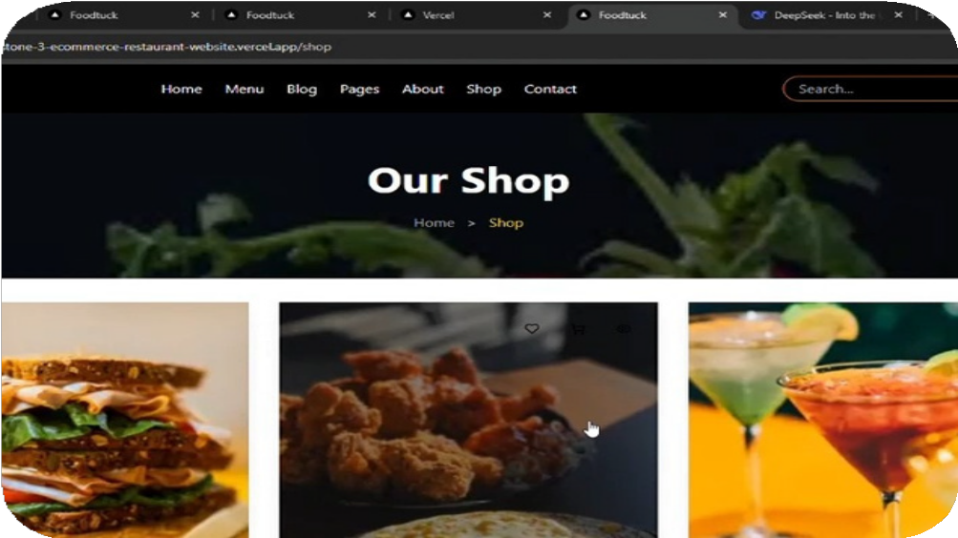
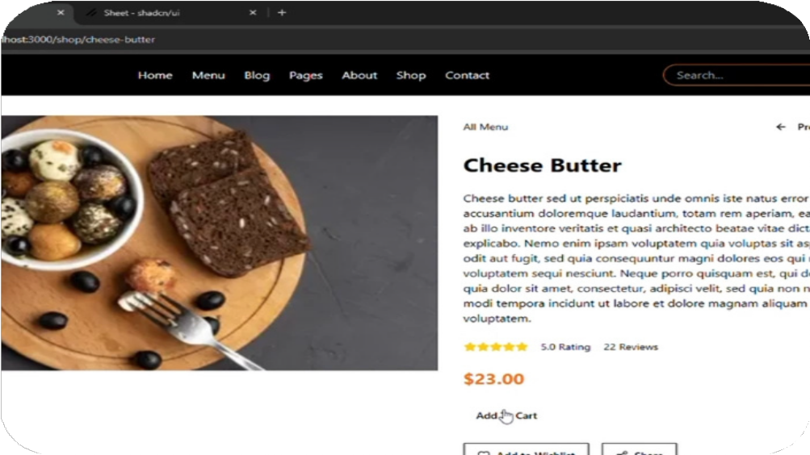
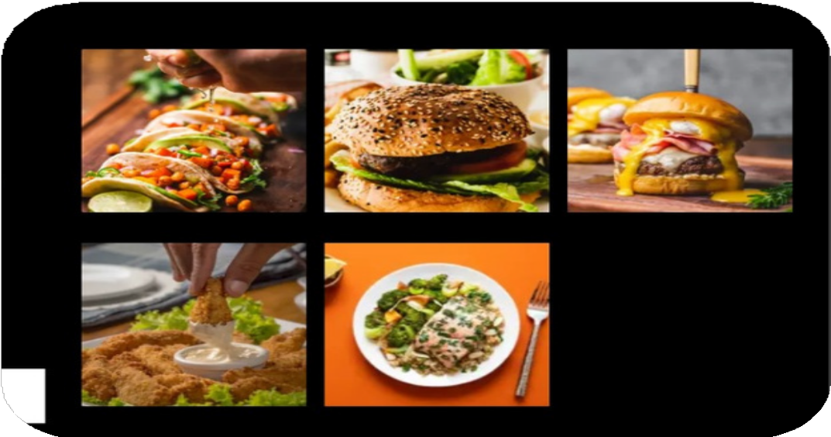
O U R M A R K E T P L A C E – F E A T U R E S & E X P E R I E N C E
User-friendly Platform: Seamless ordering and delivery.
Wide Selection: Variety of food options from local vendors.

Slide 10
H O W W E W I L L R E A C H C U S T O M E R S
Social Media Ads: Targeted campaigns on Instagram, Facebook, and other platforms.
Referral Program: Incentives for users to invite friends.
Partnerships: Collaborations with local food businesses.
SEO & Content Marketing: Blog & influencer collaborations.
Promotional Offers: Discounts for first-time users.

Slide 11
Year 1
Growth projections based on market trends.
P A T H T O I N T E G R A T I O N
Year 2-3
Expected revenue & operational costs.
Break even point
When FoodTuck is expected to be profitable
Investor ROI
Potential returns for investors.

Slide 12
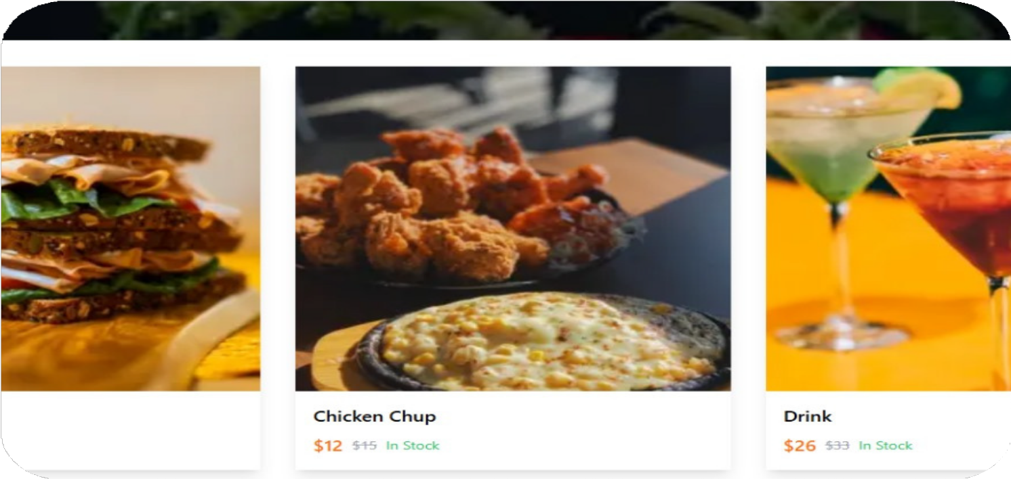
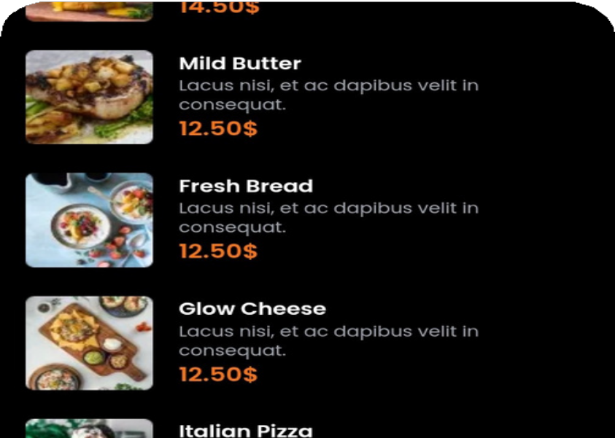
J O I N U S I N T R A N S F O R M I N G F O O D D E L I V E R Y
Why Invest in FoodTuck?
Easy to get in touch with your restaurant, scalable, high-demand, unique approach.
Contact Info:
Email: shezanusman08@gmail.com LinkedIn:
Muhammad Shezan

Slide 13
Thank you!
R E G A R D S : M U H A M M A D S H E Z A N

